Slide 1
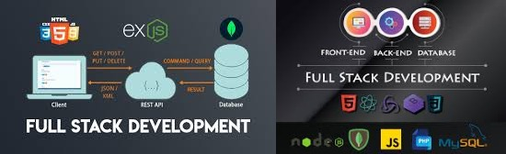
Full Stack Web Developer Current and Future Trends
DATE AND TIME: Date: 30th September, 2024 at 11:30 AM.
PRESENTED BY MAHESHWER_CHOWDEYKARI

Slide 2
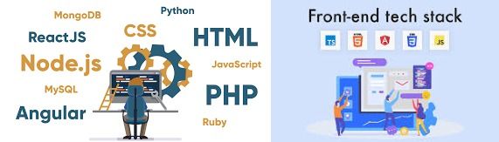
Overview OF Full Stack Web Developer
Full Stack Web Developers are skilled in both frontend and backend technologies, handling the complete web development process.
They manage everything from user interfaces to server-side logic, databases, and API integrations.
The demand for these versatile professionals is high, driven by the growing digital economy and tech innovation.
PRESENTED BY
MAHESHWER_CHOWDEYKARI

Slide 3
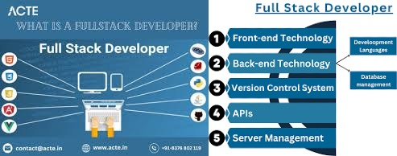
Role of a Full Stack Developer
Role of a ull Stack Developer key responsibilities
Developing user interfaces
Building server-side logic
Working with databases
Integrating APIs
PRESENTED BY
MAHESHWER_CHOWDEYKARI

Slide 4

Frontend Responsibilities
Building responsive web pages.
Working with HTML, CSS, JavaScript frameworks (e.g., React, Angular).
Ensuring UX/UI design is implemented
PRESENTED BY
MAHESHWER_CHOWDEYKARI

Slide 5
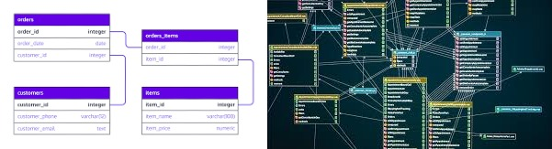
Backend Responsibilities
Creating server-side logic.
Managing databases (SQL/NoSQL).
Working with backend frameworks (Node.js, Django, etc.).
Implementing APIs and security features
PRESENTED BY
MAHESHWER_CHOWDEYKARI

Slide 6
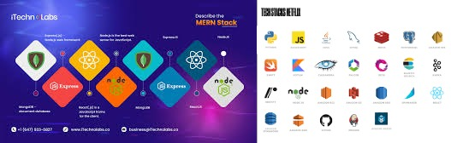
Essential Skills of a Full Stack Developer
Frontend: HTML, CSS, JavaScript, React/Angular.
Backend: Node.js, Django, Ruby on Rails, etc.
Databases: MySQL, MongoDB.
Version control: Git.
Deployment: Cloud platforms (AWS, Azure)
PRESENTED BY
MAHESHWER_CHOWDEYKARI

Slide 7
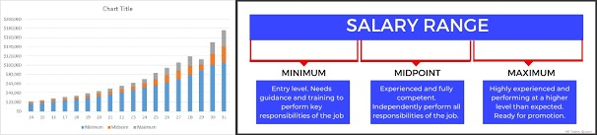
Salaries of Full Stack Developers in India (2024)
Entry-Level: ₹3-6 LPA (Lakhs per annum).
Mid-Level: ₹6-12 LPA.
Senior-Level: ₹12-25 LPA and above
PRESENTED BY
MAHESHWER_CHOWDEYKARI

Slide 8

Factors Affecting Salaries
Location (Bangalore, Delhi, etc.).
Company (MNC vs Startup).
Experience and Skillset
PRESENTED BY
MAHESHWER_CHOWDEYKARI

Slide 9
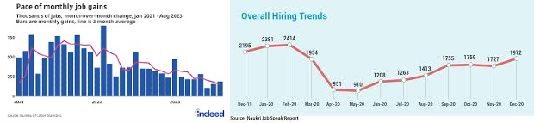
2024 Demand for Full Stack Developers
High demand due to growing startups and tech companies.
Requirement for versatile developers who can handle both frontend
and backend.
PRESENTED BY
MAHESHWER_CHOWDEYKARI

Slide 10

Future Demand Outlook for FSWD
AI and machine learning integration.
Cloud-based applications.
Growing emphasis on microservices architecture.
Expected 20-30% increase in demand over the next 5 years
PRESENTED BY
MAHESHWER_CHOWDEYKARI

Slide 11
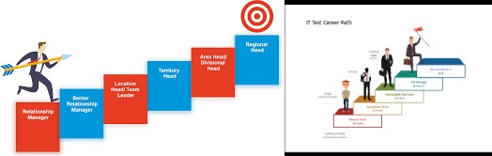
Career Path for Full Stack Developers
Junior Developer.
Mid-Level Developer.
Senior Developer.
Lead Developer or Architect.
CTO/Tech Lead roles
PRESENTED BY
MAHESHWER_CHOWDEYKARI

Slide 12

Top Companies Hiring Full Stack Developers in India
Amazon.
Google.
Flipkart.
Infosys.
startups
PRESENTED BY
MAHESHWER_CHOWDEYKARI

Slide 13

Conclusion
Summary of the importance and potential of Full Stack Developers in the tech world.

